Slide 1
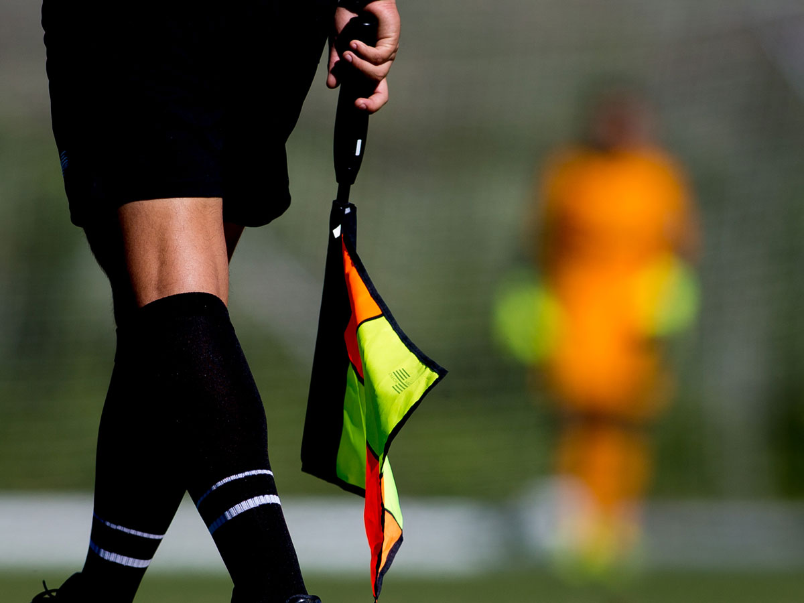
CONCUSSIONS IN SOCCER: OVERVIEW
WHAT PLAYERS, PARENTS, COACHES AND REFEREES NEED TO KNOW
Notes:
Welcome to the U.S. Soccer Federation’s presentation on Concussions in Soccer Overview: What Players, Parents, Coaches and Referees Need to Know.

Slide 2
WE ALL HAVE A ROLE TO PLAY
Keeping soccer safe and enjoyable is the job of everyone involved
  Players
  Parents
  Coaches
  Referees
We all have a role to play in protecting the safety of the players
Notes:
Success in soccer is impossible without teamwork both on and off the field.
It’s only when players, coaches, parents and referees work together for exciting, but safe play that we protect both the players and the game.
To help lead this team, U.S. Soccer is elevating the safety of its players above the game through education, research and rule changes.
As is the case in any sport, there is a risk of injury but many injuries can be prevented, if players, parents, coaches and referees work together.
To help prevent injuries, players should use proper technique, practice good sportsmanship and avoid playing in a dangerous manner.
Parents should encourage safe gameplay, and recognize when a child is hurt and needs immediate medical attention.
Coaches should educate parents and athletes, as well as identify when athletes are injured and need to be removed from the game or training.
Referees should control the pace of the game, making it important that they know when athletes are hurt and need to be taken out of the game.

Slide 3
WHAT PLAYERS NEED TO KNOW
Be alert
Be honest about injuries
Listen to your coach and referees
Know the cues
Protect yourself and teammates
Speak up
  Tell a parent and coach
Notes:
To compete at the highest level your skill can take you, you have to be able to stay on the field and in the game.
You are your best defense in preventing injury.
Always be aware of your surroundings, and realize that injuries occur more often than you think, in situations that often appear harmless.
Head injuries are serious so always be open and honest about a potential injury.
You can get a concussion from getting hit in the head or body, falling to the ground or colliding with the ball or another player.
You can have a concussion even if you weren’t knocked out.
Win or lose, it’s important how you play the game.
Use the correct techniques your coach taught you, practice good sportsmanship and avoid dangerous play.
Also be sure to listen the referee and follow the rules of the game.
There shouldn’t be any unnecessary, rough tackling, or moves that put yourself, or others, in danger.
Your health, and your teammates’ health, is more important than the number on the scoreboard.
See beyond the game, and beyond a world of soccer.
Take the steps needed to take care of your body and stay in the game of life.
You should also know the symptoms of a concussion include: headache or “pressure” in head; dizziness; sensitivity to light and noise; confusion; and/or not “feeling right.”
While some injuries may appear similar, symptoms are different for everyone, and they may not be noticeable for hours or days.
Playing the game safely isn’t just about recognizing the signs of injury in yourself, but in your teammates as well.
Look for signs and symptoms among all the players on the field to ensure you all are playing in a safe environment.
And, never pressure a teammate to play through an injury.
If you think you have a concussion, tell a parent and coach.
A healthcare professional can diagnose a concussion and tell you when you are okay to return to play.
Tell your coach if you think one of your teammates might have a concussion.
Playing or practicing with concussion symptoms is extremely dangerous and can lead to serous injury, a longer recovery, as well as a delay in your return to play.

Slide 4
WHAT PARENTS NEED TO KNOW
Pay attention
Communicate
  Talk with the coach
  Make sure he or she knows the protocols and will follow them
Be a parent
Know the cues
Allow for complete recovery
Notes:
Be a role model for your child and show that you appreciate a safe soccer game by being respectful to the coaches, referees and other parents and athletes.
It’s encouraged that parents attend practice and games to see what the coaches are teaching.
It’s also important to ensure that your child understands the expectation of good sportsmanship and avoiding dangerous gameplay.
Talk to your child’s coach and make sure they know about any recent concussion in any sport or activity.
The coach may not know unless you tell him or her.
Check that your son or daughter's coach knows what steps to take in case of a suspected concussion and make sure they are committed to player safety over results in the game.
Be a parent ahead of being a fan.
See beyond the game, and plan for your child’s life ahead of soccer.
One day, the cleats will no longer be needed and life will continue on so you need to recognize when a child is hurt and needs immediate medical attention.
Look for the symptoms of a concussion.
For example is your child confused, and/or do they have a major change in their attitude or performance?
Don’t let your child return to play until a healthcare professional knowledgeable in the diagnosis and management of concussions gives the okay.
Concussions take time to heal so allow your child to take as much time as needed to recover fully.

Slide 5
WHAT COACHES NEED TO KNOW
Set the tone
  You are the role model and leader
Build the basics
  Focus on proper technique in training, good sportsmanship and player safety
Take the lead
Be informed
  Keep open lines of communication with parents
Consider all perspectives
Notes:
As a coach, you have a key role in preventing injuries.
Athletes and parents look up to your leadership so make sure they understand the expectation of good sportsmanship and avoiding dangerous gameplay.
Setting the tone is important.
Coaches play a big role in the personality of a team and safety should be part of it.
Make sure that safety and technique are the first order of business when addressing your team and that they remain a constant priority throughout training.
Just as with referees, it’s your job to make sure player safety is the utmost priority.
Teach athletes safe playing techniques and require them to follow the rules.
Take the lead in educating athletes and parents about concussions.
Talk about the dangers and potential long-term consequences of concussion.
Coaches, parents and teammates should never pressure an injured athlete to play.
Be informed by checking with your youth sports league or administrator about concussion policies.

Slide 6
WHAT COACHES NEED TO KNOW
Know the cues and take action
  The player’s health and safety is the priority
  Don’t put a player back in the game without clearance from a healthcare professional
  The referee will keep stopping the game unless the player is properly cleared
General prevention and care
  Top 10 safety guidelines for players
Notes:
Look through parents’ eyes when looking at players on the field and see a life yet to be lived rather than only the game being played.
You have a responsibility to identify when your athletes are hurt, and when they require immediate medical attention.
As a coach, you also have to know the cues and be ready to take action.
Some signs of concussion include: confusion, memory loss, and/or a change in attitude or performance.
When a concussion is suspected, remove the athlete from play.
Ensure that the athlete is evaluated right away by an appropriate healthcare professional, and don’t try to judge the severity of the injury yourself.
No matter the level of competition or the score of the game, don’t ever risk the player’s health by putting them back in the game unless cleared by a healthcare professional.
You also have a responsibility to introduce the healthcare processional to the referee before the game so he or she knows who will be clearing the players as needed.
If a healthcare professional is not available to evaluate the player, don’t allow him or her to reenter the game; no excuses.

Slide 7
WHAT REFEREES NEED TO KNOW
Communication
Know the cues
Take action
  Stop play and allow the player to get immediate medical attention
  Before reentering, ask if the player has been cleared by a healthcare professional.
Notes:
Enforcing the rules of the game rests on your shoulders, and as a referee, you play a key role in preventing injuries.
Ensure that athletes, coaches and parents understand the expectation of good sportsmanship and following the rules.
If players are being aggressive and/or disrespectful, you have the ability to slow down the game and set the tone.
Remember that ensuring player safety is the first priority of referees at all levels of the game.
When a concussion is suspected, stop play so the athlete can be evaluated right away by an appropriate healthcare professional who has experience in diagnosing concussions.
Don’t try to judge the severity of the injury yourself.
A player should not return to play unless cleared by a healthcare professional and don’t hesitate to stop the game again and repeat the process should a player appear to be injured after returning to the game.
Make sure to ask the coach to introduce you to the healthcare professional before the game so you exactly who will be clearing the players if needed.

Slide 8
WHAT REFEREES NEED TO KNOW
Take action
  If the player has not been cleared by a healthcare professional, allow the player to reenter and then immediately stop the game again and have the player removed.
  Repeat this process until the player is cleared by a healthcare professional or until the coach stops putting the player back into the game.
Notes:
If the player has not been cleared by a healthcare professional, allow the player to reenter and then immediately stop the game again and have the player removed because of the suspected concussion.
Remind the coach that this process will be repeated until the player is cleared by a healthcare professional or until the coach stops trying to have the player reenter the game.

Slide 9
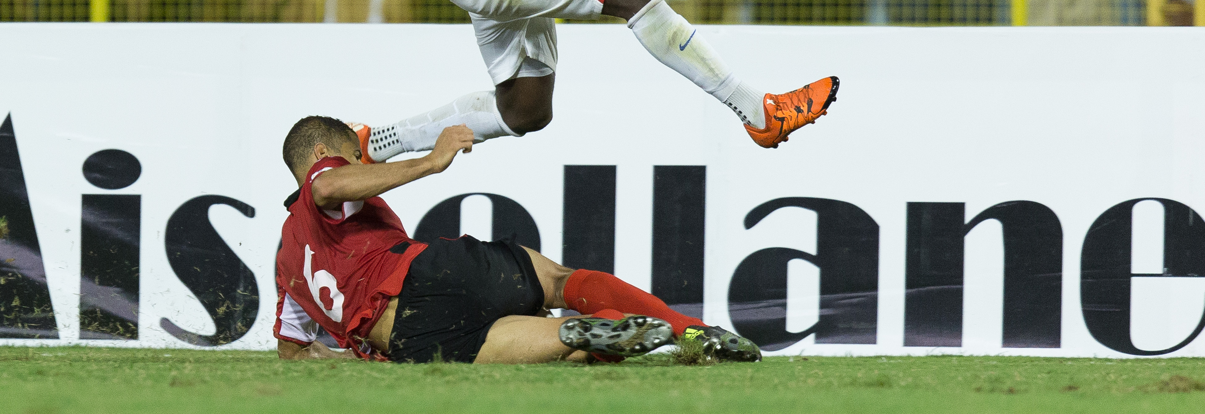
HEALTHCARE PROFESSIONAL
The healthcare professional should be a licensed healthcare professional such as an athletic trainer (ATC), or a physician (MD/DO), with a skill set in emergency care and sports medicine injuries and with knowledge and experience related to concussion evaluation and management.
Notes:
The healthcare professional should be a licensed health care professional such as an athletic trainer (ATC), or a physician (MD/DO), with a skill set in emergency care and sports medicine injuries and with knowledge and experience related to concussion evaluation and management

Slide 10
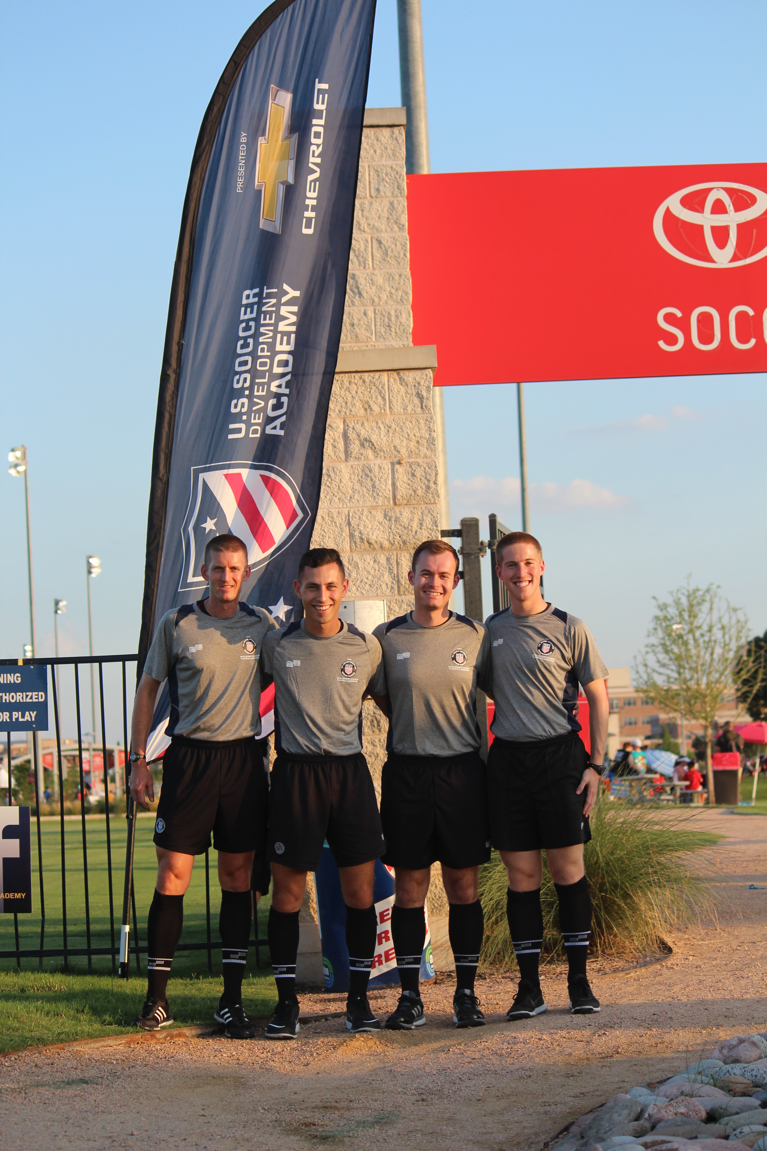
REVIEW QUESTIONS
REVIEW QUESTIONS

Slide 11
REVIEW QUESTIONS
Who is responsible for player safety in soccer?
Parents
Coaches
Referees
Players
All of the above

Slide 12
REVIEW QUESTIONS
As a player, what should you do if you suspect one of your teammates has a head injury?
Don’t tell anyone- you need your teammate to play so you can win games
Tell your coach or the referee immediately

Slide 13
REVIEW QUESTIONS
Should a player pressure a teammate who is injured to play?
YES
NO
It’s appropriate to pressure a teammate because the result of the game is more important than his or her health and safety
Players should never pressure teammates to play if they are injured or have a suspected injury

Slide 14
REVIEW QUESTIONS
Should parents ask the coach if he or she
understands and will abide by the concussion protocols?
YES
NO
The coaches are an important part of protecting the safety of players, and knowing their role in the concussion protocols is imperative
Coaches shouldn’t be bothered with player safety

Slide 15
REVIEW QUESTIONS
Should parents inform the coach if their child has had a recent concussion in any sport or activity?
YES
NO
The coach may not know unless told, and safety should be the primary focus for all players
Because then the coach might not allow the child to play

Slide 16
REVIEW QUESTIONS
Should a coach ever put a player back into a game
that hasn’t been cleared by a healthcare professional?
YES
NO

Slide 17
REVIEW QUESTIONS
Should a coach know and be able to identify the signs of a concussion?
YES
NO
Coaches have a responsibility to identify when their athletes are hurt and when they require medical attention
Only healthcare professionals need to know the signs of a concussion

Slide 18
REVIEW QUESTIONS
If a healthcare professional is not available to evaluate a player, can a coach clear the player to reenter the game?
YES
NO
Coaches can judge the severity of the injury even if they are not knowledgeable in the diagnosis and management of concussions
Coaches cannot allow the player to reenter the game; no excuses

Slide 19
REVIEW QUESTIONS
Can a referee allow a player back into the game
that hasn’t been cleared by a healthcare professional?
YES
YES, BUT…
The coach is allowing the player to return so the player must be fine
…He or she must then stop the game immediately and have the player removed

Slide 20
REVIEW QUESTIONS
If a concussion is suspected, should the referee wait for a natural stoppage in play to take action?
YES
NO
Concussions are not serious enough where immediate attention is needed
The referee should stop play immediately and allow the player to get medical attention

Slide 21
REVIEW QUESTIONS
Should the referee ask to be introduced to the healthcare professional before the game?
YES
NO
The referee needs to know exactly who the healthcare professional is and where they will be during the game
The referee does not need to know who the healthcare professional is

Slide 22
REVIEW QUESTIONS
What is the first priority of a referee?
Ensuring player safety
Making sure the game gets played
Determining a winner of the match
Recording misconduct

Slide 23
WE ALL HAVE A ROLE TO PLAY
U.S. Soccer’s commitment
Player safety is the priority
We all have to contribute to the sport we all love
More information and resources:
  ussoccer.com
  SCAT3
  CDC Heads Up Training
  CDC Heads Up Resources
Notes:
As a national governing body of a major sport, U.S. Soccer is committed to making lasting changes that have positive impacts on the game.
We’ve recently identified rule changes that will reduce injury risk, while preserving the exciting, fast-paced nature of the game that players and fans have come to know and love.
We’ve appointed a Chief Medical Officer, and we’re funding research to dig deeper into the causes of injuries and how we can prevent them to illustrate our commitment to making sure soccer continues to be safe, and strives to be even safer.
All of us who love the game have a role in preserving it so it can continue to be played.
U.S. Soccer wants everyone on, or around the field to help prevent and respond appropriately to serious injuries.
Whether you are a player, parent, coach or referee, there are new resources available to you to help keep the game safe to play and exciting to watch.
Everyone has the ability to prevent and respond to an injury, and the first step is to be alert.
It’s important to pay attention to what’s happening on the field, and react to the symptoms when present.
Go to our website to learn about common injuries in soccer, ways to prevent them and how to identify their symptoms.

Slide 24
USSOCCER.COM

